Slide 1
The Basics to Programming 4
A Series of Bite Size Lessons for Programming
User Input and Methods
By Tariq Chatur

Slide 2
Introduction
Now that you have completed Lesson 3, you should have a basic understanding of how to use Loops. In this lesson you will look into how to take input from a user and how to write methods.
Taking input from user using the Read-Host command
Methods are a great way to organise code and reduce the number of

Slide 3
Input Gathering
There are many ways to get input from a user
A form (Basic UI)
The command line (Least Effort)
A website (Most Customisable)
A system event (A button click or system call)
Many programs are only as good as their ability to gather a user’s input, while we won’t look into the best methods of collecting inputs, remember to keep in mind that a bad UI can make or break any program

Slide 4


Input Example
This example will highlight the capabilities and structure of user input.
We will ask for the name of the user and print a message to them using the Read-Host command

Slide 5
Input Example Overview
In this example we show the functionality of Read-Host as a method of taking an input from a client.
Read-Host prompts the user for an input through the command line using whatever value is placed in the ().
Whatever is typed in, is then saved as a String into a variable if the value is saved.
This means that if you are taking numbers as an input, you will need to convert them from Strings to Numbers

Slide 6
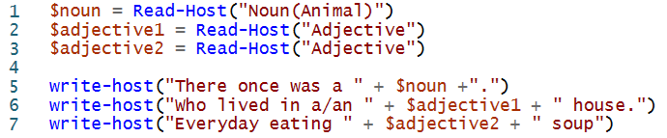
Input Exercise
Make a script that Replicates a MadLib:
Ask for a series of words to fill in the blanks of a story. Then read the story out to the user.
The MadLib only needs to be three lines long and ask for three words.
Answer

Slide 7
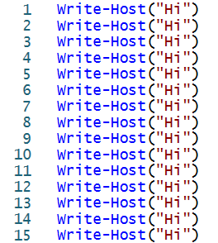

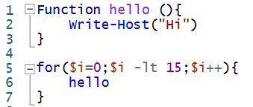
Methods Introduction (Reusability)
Methods are a powerful tool in programming as they allow for us to reuse and reduce the code that we write. This is also key for organising code.
Without Methods:
With Methods:
* Writing Hi 100 times without a method and loop would require 100 lines of code, but with methods and a loop it stays at 8

Slide 8
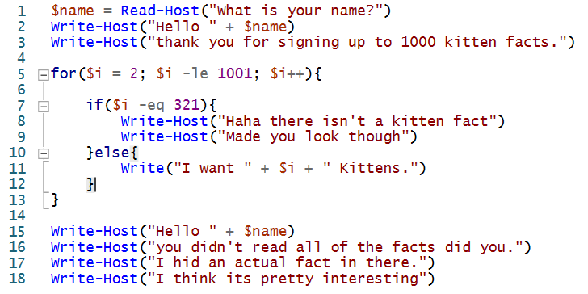
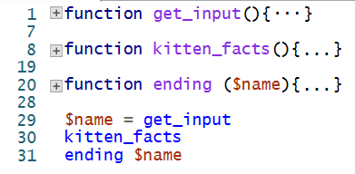
Methods Introduction (Organization)
Methods make code cleaner to read which means that looking through code can be easier to understand and update.
Without Methods:
With Methods:
* In the industry code is written in a similar way to the way on the right. Lets say someone wants to change the ending message, it is much easier to find the section using methods.

Slide 9
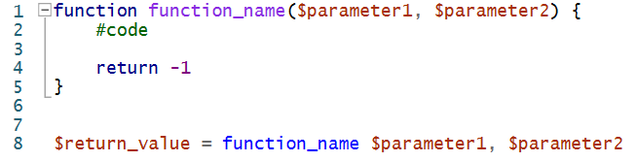
Methods Structure 1
Breakdown of the method construction:
function:
This is the indicator that a function is being initiated
function_name: The name of the function
$parameter1: Values that can be passed into the function
#code : This is a comment indicating where the repeated task will go
return: The value that will be saved where the function is called
Line 8: How to call our function

Slide 10
Methods Structure 2
How the function works:
When the script is reading lines of code, it will skip whatever is within the brackets after the keyword function.
Then, when the code reaches a reference to the function_name it will jump to the function with the appropriate function_name and run whatever is within the brackets.
Remember Scope. Values that are in other methods cannot be shared unless passed in through the parameter field. in addition, if you require values from the method you can get them by returning them at the end of your method. Using the return keyword will exit the function.

Slide 11
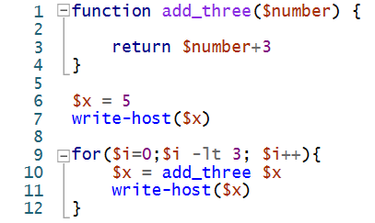

Method Example
In this example we make a function called add_three. This allows us to call the task of adding three as many times as we need. We give the function a number and then save the number it spits out. The function prints out every addition.
add_three’s description:
Parameters: a number
Returns: a number + 3

Slide 12

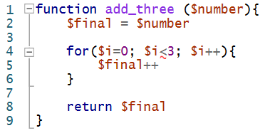
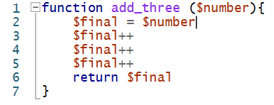
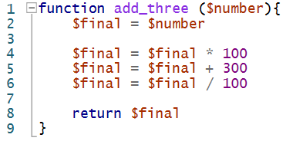
Method Example Review
Methods are a powerful tool as they allow for code visibility to play a big role in collaborative writing.
It makes code easier to understand and it lets others rely on your code without needing to know your code.
Take the below example, it doesn’t matter which add three implementations is used as long as it performs how it was described in the previous slide. This also means it can be changed, improved, and debugged easier.
One thing to keep in mind is that coding is a collaborative task, so make sure to share and look online for code and ideas.

Slide 13
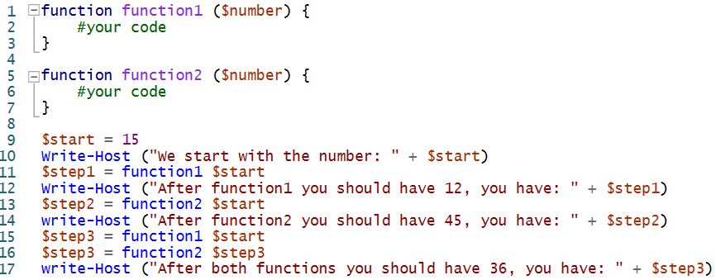
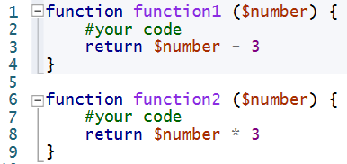
Method Exercise
Answer
Complete the script below:

Slide 14
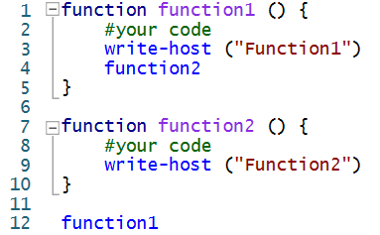

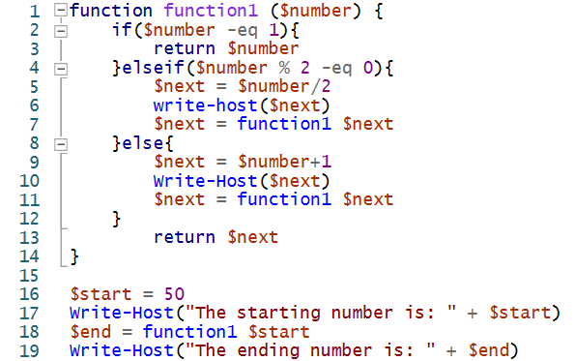

Other Method Uses
*Remember Scope as it will haunt you in methods if you don’t have a grasp of when you can use your variables.
Nested Methods
Recursion
Recursion is a pretty complex concept, I am introducing it here but won’t go into more detail. I recommend looking at it. While it doesn’t appear often, it does come in handy to understand.

Slide 15
Lesson Review
The simplest way to get input from a client is to go through the command line. Once you can get client input, you can really take tool creation to the next level
Methods are key for organizing code and debugging. In addition, methods can be nested and looped through.
You now have all the tools needed to make most tools in the world. Now the only things you need are an understanding of the system you want to work with, the language you are limited to, and problem solving skills.

Slide 16
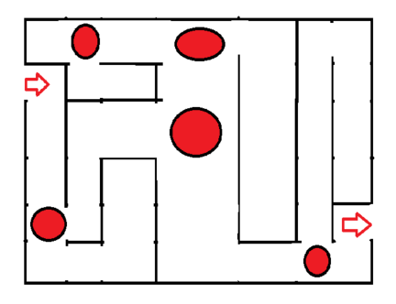
Review Exercise I - Task
Your task is to make a program that replicates the traversing of the maze below with a compass.
Tasks:
If the user reaches a turn, let them know
If the user reaches a cross roads, ask them which way they want to go
When they reach a dead end, let them know and prompt them to turn around
Use Cardinal Directions when telling saying which way they are walking. And indicate how far they are walking
When they get out of the maze, congratulate them
If they use the optimal path congratulate them again (Optional)

Slide 17
Review Exercise I - Hints
Hint
When asking for which turn to do, use 1 = North, 2 = East, 3 = South, and 4 = West to make it easier to play
Hint
Make a function for each of the crossroads and have if statements to choose which function to call
Hint
Make a function for each dead end so you can manage backtracking
Hint
Pretend the maze is a grid to keep track of walking distances and positions

Slide 18
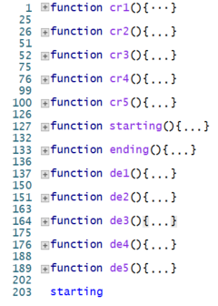
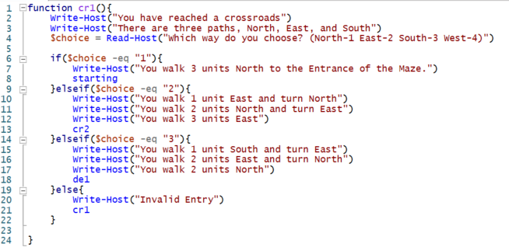
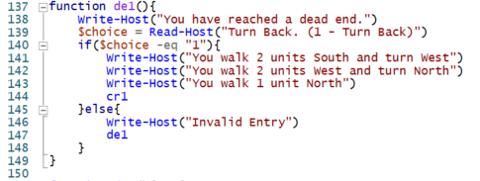

Review Exercise I - Solution
The full solution will be posted as a .ps1 file for you to try called Maze Game. It does not have the optional task completed
Answer

